Slide 1
Understanding property values is essential in real estate. In this presentation, we'll use linear regression to predict house prices based on the number of bedrooms, uncovering how this key feature influences market value.“ Objective: To develop a model that estimates house prices using the number of rooms as the primary feature.

Slide 2
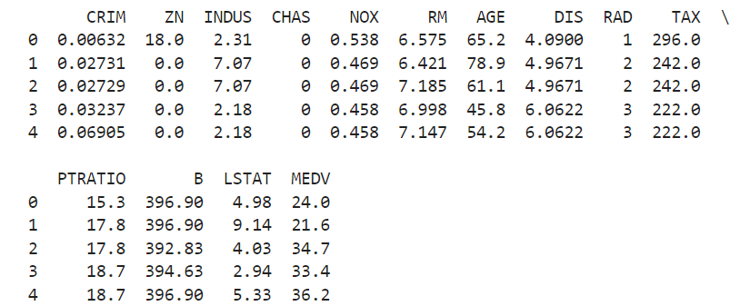
Source: Boston Housing Dataset (UCI Machine Learning Repository)
Description: Contains various features about houses in Boston, including the number of rooms (RM) and the median house value (MEDV).

Slide 3
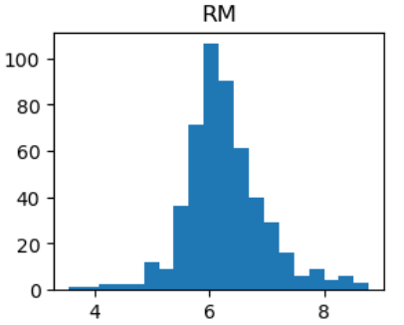
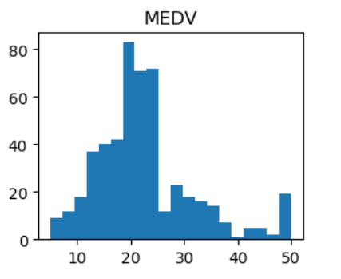
These histograms provide a clear picture of the data distribution. The concentration in the number of rooms and the skew in home values are critical for understanding market dynamics and for making predictions based on these features.

Slide 4
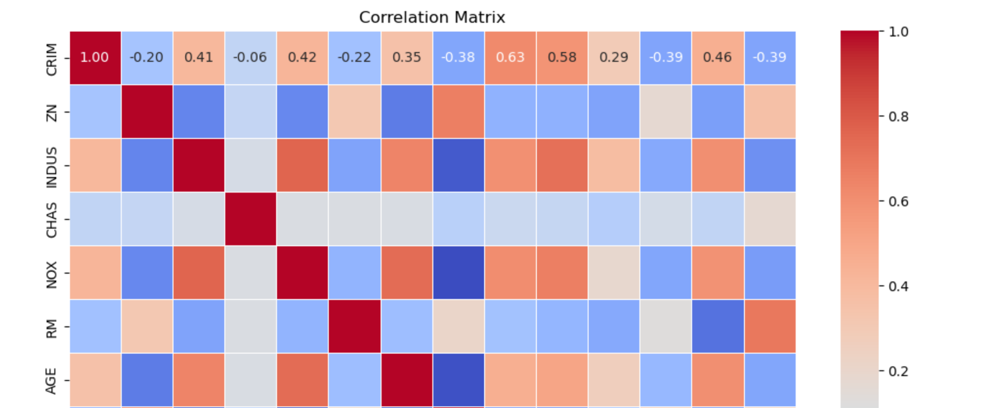
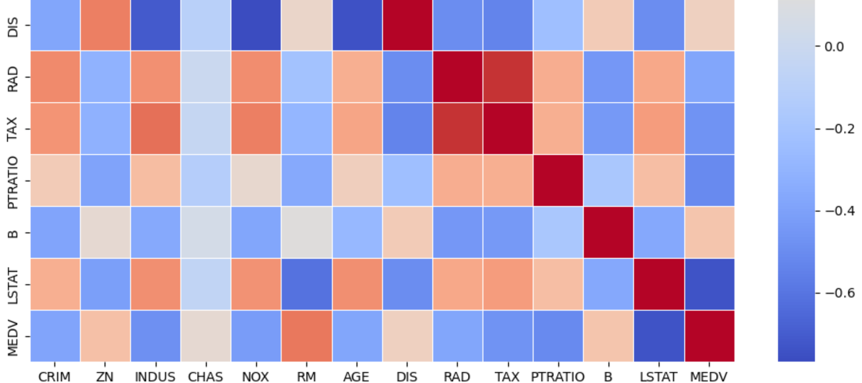
Correlation Matrix

Slide 5
.
.
Title:
Linear Regression Model for Predicting Property Price
(
Where:Intercept: -36.25
Coefficient: 9.35
Model Insights:The positive coefficient indicates that larger homes (with more rooms) are associated with higher median values, which aligns with common market trends.
The intercept value, while negative, ensures that the regression line is properly positioned to fit the data points

Slide 6
Slide Title: Model Evaluation
Mean Squared Error (MSE): 46.14
Definition: Measures the average squared difference between actual and predicted values.
Interpretation: Indicates the level of prediction error; lower values are better.
R-squared (R² Score): 0.37
Definition: Represents the proportion of variance explained by the model.
Interpretation: Shows that 37% of the variance in median home values is explained by the number of rooms. Indicates moderate model performance.

Slide 7
. Title: Evaluating Model Performance with Cross-Validation
An MSE of 46.14 indicates the average squared error of the model’s predictions. Lower values signify better performance. This value suggests moderate prediction errors, indicating there may be room for improvement in the model’s accuracy.
An R² score of 0.37 means that approximately 37% of the variance in the median home values can be explained by the number of rooms. This implies that while the model captures some variability in home values, there is a significant portion (63%) that is not explained by the model, suggesting the presence of other influencing factors.

Slide 8
Title: Model Prediction: Median Home Value
Model Prediction:
Predicted Median Home Value: $10,495 (in thousands of dollars)
Context and Interpretation:
Represents the estimated median value of an owner-occupied home based on the number of rooms.
Example: For a given number of rooms, the model predicts a home value of approximately $10,495,000.

